Slide 1
Sanchi Incident
A different perspective…….

Slide 6
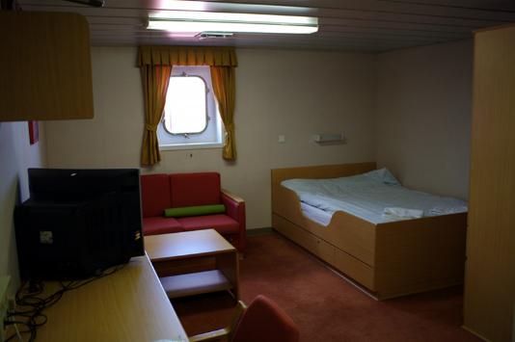
3/0 left his cabin

Slide 7
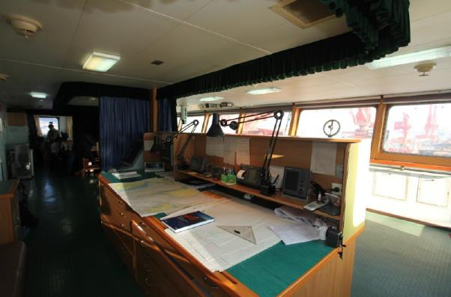
3/0 arrived on the bridge

Slide 8
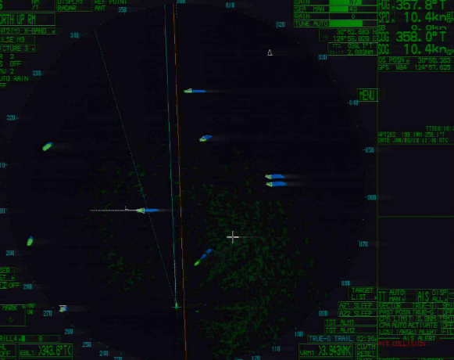
C/O left the bridge “the traffic is clear”

Slide 9
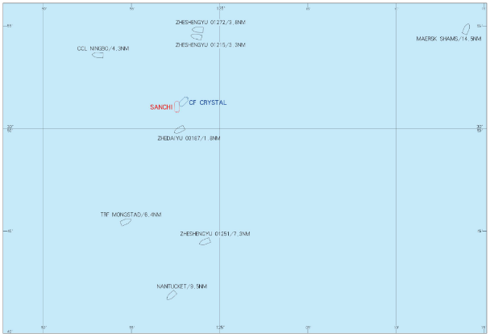
Collision with MT Sanchi

Slide 10
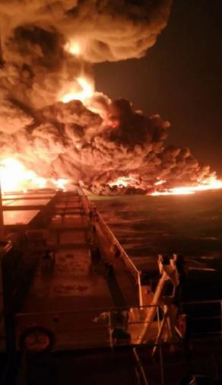
Fire onboard

Slide 11
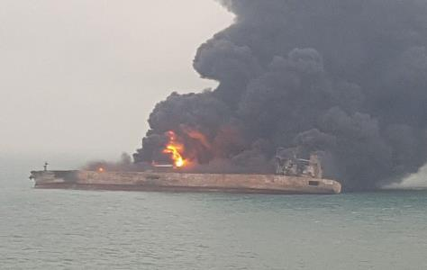
Explosion and loss of all communication

Slide 15
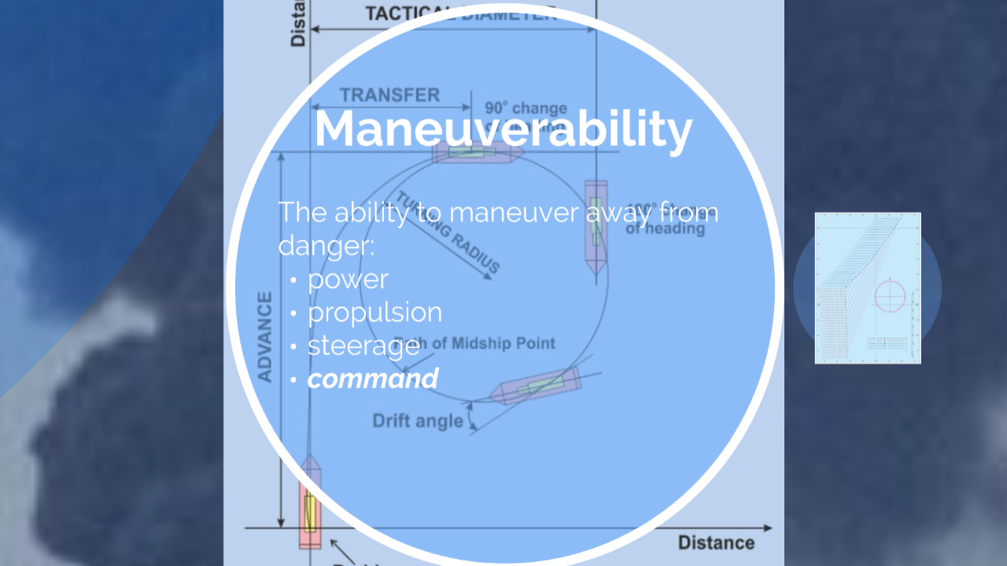

Slide 23
